Slide 1
Managing Information Technology Resources ITWS 4310
Amazon Case
October 11, 2018

Slide 2
Managing IT Resources Class Outline: Thurs, Oct 11, 2018
MITR Term Project
Schedule Meetings with Client and Invite Faculty to Meetings
Work on Design and Development of Project
Mid-Term Exam on Monday Oct 15 during class from 10 AM – 11:50 AM
Exam will be in Lally 102
See past Mid-Term Exams posted on LMS
Note: Final Exam schedule is out
Wednesday December 19 from 11:30 AM – 2:30 PM
Location TBD
Current Events
Amazon Case

Slide 3
Technology Current Events: “Here are all the gadgets Google just announced in one 48-second video”, Insider, Oct 9, 2018 https://www.thisisinsider.com/google-video-shows-pixel-3-google-home-hub-and-pixel-slate-in-under-a-minute-2018-10
Google launched a bunch of new products, including the Pixel 3 smartphone, at an event on Tuesday in New York.
But you don't have to watch the entire event to get the lowdown — Google itself posted an unlisted video to YouTube showing off all its new gadgets just minutes before the event started. Google quickly pulled the video, but we were able to save a copy:
The video shows off the Google Pixel 3, the Google Home Hub smart speaker, and the Pixel Slate tablet.

Slide 4
Technology Current Events: “Snap takes on Netflix with new short-form 'Originals’”, Engadget, Oct 10, 2018 https://www.engadget.com/2018/10/10/snap-originals-docuseries/
Snap chief Evan Spiegel recently told employees in an internal letter that it's putting a focus on Shows in an effort to achieve full-year profitability in 2019. It looks like the company is going full steam ahead with that strategy, because it has just revealed quite a lengthy list of new scripted originals and docuseries titles. The app will roll out the first episodes for two of the scripted shows and one docuseries sometime today.
While they're far from the first slate of original programming on the platform, these new titles mark the launch of "Snap Originals" as a format. Snap will release one fast-paced, five-minute episode for each title every day. They're short and explosive, because they were specifically created with mobile users in mind, but the platform promises that each episode still has a beginning, a middle and an end. In addition, the company has created interactive augmented reality elements for some episodes to make them fun and immersive.

Slide 5
Technology Current Events: “Snap slides to record low after announcing scripted shows”, Business Insider, Oct 10, 2018 https://markets.businessinsider.com/news/stocks/snap-stock-price-record-low-scripted-shows-announcement-2018-10-1027605434#
Even the announcement of new scripted shows isn't helping lift Snap's share price, which hit a record low Wednesday morning.
After briefly jumping 2% in premarket trading following the announcement of the new shows, called Snap Originals, shares slid into the red as the market opened, touching a new low of $6.80 apiece.
Snap's stock has been hammered this year as the company's photo-sharing app, Snapchat, struggles to keep pace with Facebook's Instagram.
Earlier this year, Instagram said more than 400 million people used its Stories feature, an amount nearly twice that of Snapchat's daily active users. After releasing a largely unpopular app redesign in February, Snap reported that Snapchat's daily active users fell for the first time on record during the second quarter.

Slide 6
Technology Current Events: “Can Snap Afford Evan Spiegel's Big Plans?”, The Motley Fool, Oct 9, 2018 https://www.fool.com/investing/2018/10/09/can-snap-afford-evan-spiegels-big-plans.aspx
Snap (NYSE:SNAP) CEO Evan Spiegel rallied his troops with a 6,000-word missive at the end of September. Among his objectives was refocusing on the core product value of being the fastest way to communicate; he expects this to result in a return to user growth, particularly in emerging markets.
In fact, analyst Michael Nathanson points out that Snap is "quickly running out of money," as Bloomberg reports. He expects Snap to lose $1.5 billion next year as it invests to grow the user base. Unless Snap makes some serious cost cuts, either user growth or profitability has to give.
The biggest challenge Snap faces in growing its user base and producing improvements in cash flow at the same time is that Snap's user growth and cash expenditures move in lockstep. That's because Snap never made the switch to building and operating its own servers, like other web companies of its size. Instead, it's relying on the cloud computing services of Amazon and Alphabet's Google.
So each new user adds to the cloud infrastructure costs Snap pays its cloud providers. That would be fine if Snap can generate more revenue from those users than it pays its server providers, as it does in North America. But that's not the case everywhere in the world. In Europe, for example, Snap generated just $0.66 in revenue per user in the second quarter. Infrastructure costs during the same period totaled $0.72 per user.

Slide 7
Amazon Case
What is the history of Amazon?

Slide 8
Amazon Case
What is the history of Amazon?
1995 Bezos launches online Bookstore
Mocked by Trade for 7 years without profit
$3B loss, stock price goes from $100/sh to $6/sh
2002 introduce Kindle
2006 introduce Amazon Web Services (AWS)
2014 introduce FirePhone
2015 overtook Wal-Mart as largest global retailer
2015 introduce Echo broadly
2017 bought Whole Foods

Slide 9
Amazon Case
In what businesses does Amazon compete?

Slide 10
Amazon Case
In what businesses does Amazon compete?
Online Retail
Cloud Computing and Web Services (AWS)
Platform for 3rd Party Retail – Marketplace
Home appliances – Echo - information services
Publishing / TV / Media Production
App Store
Devices such as Kindle and Firephone

Slide 11

The Businesses of Amazon
Market
Place
Books and
Electronics
AWS
Kindle
VOD
Ad Network
Search
Studio
Phone
AppStore

Slide 12
Amazon Case
Who are Amazon’s competitors?

Slide 13
















The Competitors of Amazon
Market
Place
Books and
Electronics
AWS
Kindle
VOD
Ad Network
Search
Studio
Phone
AppStore

Slide 14
What is the “Porter Five Forces of Competition” analysis for the “Internet Services” Industry?
Suppliers
Potential
Entrants
Industry
Competitors
Substitutes
Buyers

Slide 15
Suppliers
Users
Content Providers
OEMs of Computers,
Communications Equip
Power of Suppliers is
Low
Competitiveness of Internet Services is Low-Med
Potential
Entrants
Yet unknown
Start-ups
Power of Entrants
is Med
Industry
Competitors
Facebook, Google,
Amazon, Twitter,
LinkedIn
Power of Industry Comp
is Low - Med
Substitutes
Wearable Device SW
Power of Substitutes
is Low - Med
Buyers
Users spend their time
Advertisers
Power of Buyers is Med

Slide 16
Amazon Case
What is the competitiveness of the “Department Stores” (industry designation of www.reuters.com/finance for Amazon, e.g. Wal-Mart, Target, Amazon, Taobao) Industry based on the Porter “Five Forces analysis.

Slide 17
Suppliers
Packaged Goods,
Clothing, Groceries,
Building Supplies,
Electronics, etc
Power of Suppliers is
Low - Med
Competitiveness of Department Store (Retail) Industry is High
Potential
Entrants
Chinese, Indian,
European Retailers
Power of Entrants
is Med - High
Industry
Competitors
Wal-Mart, Amazon,
Target, Taobao, Aldi
Kroger, Home Depot
Power of Industry Comp
is High
Substitutes
P2P Exchange,
Auction,
Power of Substitutes
is Low
Buyers
Consumers, Enterprises,
Government
Power of Buyers is High

Slide 18
Amazon Case
What is the “Extended Value Chain” or “Ecosystem” for Amazon?

Slide 19
Extended Value Chain or Ecosystem
Goods Suppliers
Networks
Suppliers
Company
Channel
Customers
OEMs
ISP’s
Consumer
Amazon
Servers
Routers
Content Books
Entertain
Fedex
UPS
USPS
Enterprise
ISPs
Food
Everythng
Whole Food
Gov’t

Slide 20
Amazon Case
How has Amazon used “Scale” and “Selection” as a competitive advantage?

Slide 21
Amazon Case
How has Amazon used “Network Effects” as a competitive advantage?

Slide 22
Amazon Case
How has Amazon used “Low Costs” as a competitive advantage?

Slide 23
Amazon Case
How has Amazon used “Customer Experience” as a competitive advantage?

Slide 24
Amazon Case
How has Amazon used “Data” as a competitive advantage?

Slide 25
Amazon Case
How has Amazon used “Logistics” as a competitive advantage?

Slide 26
Amazon Case
How has Amazon used “Machine Learning” and “AI” as a competitive advantage?

Slide 27
Amazon Case
How has Amazon used “Cloud Computing” and “AWS” as a competitive advantage?

Slide 28
Amazon Case
How has Amazon used “Brick and Mortar” Retail Stores as a competitive advantage?

Slide 29
Amazon Case
What are the Revenues, Gross Profit Margins, and Net Profit Margins of Amazon, Alphabet (parent of Google), Netflix, Intel, and Cisco for the past one year (TTM – Trailing Twelve Months) and the past 5 year average as viewed at www.investing.com?

Slide 30
Amazon Case
What is the Stock Price Comparison for Amazon, Alphabet, Netflix, Intel, and Cisco for the past 5 years as shown at www.google.com/finance or www.investing.com?

Slide 31
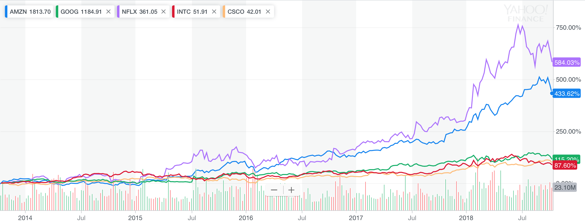
Amazon, Alphabet, Netflix, Intel, Cisco Comparison for Last 5 Years

Slide 32
Amazon Case
“Which Company: Amazon, Alphabet, Netflix, Intel, or Cisco will have the largest percentage increase in Stock Price from now over the next 5 years.
Why?

Slide 33
Managing IT Resources Class Outline: Mon, Oct 15, 2018
Mid-Term Exam on Monday Oct 15 during class from 10 AM – 11:50 AM
Exam will be in Lally 102
See past Mid-Term Exams posted on LMS

